Slide 1
Lots of other people helped…

Slide 2
Two major events have impacted kelp ecosystems on the West Coast
Marine Heatwave (2014-2016)
Large kelp die offs in some areas (esp NoCA) but not others
Sea star wasting syndrome (~2013 +)
Coast-wide die off of a potentially important mesopredator
Lots of research on kelp forests in other areas of West Coast – esp CA – but less information about WA forests

Slide 3
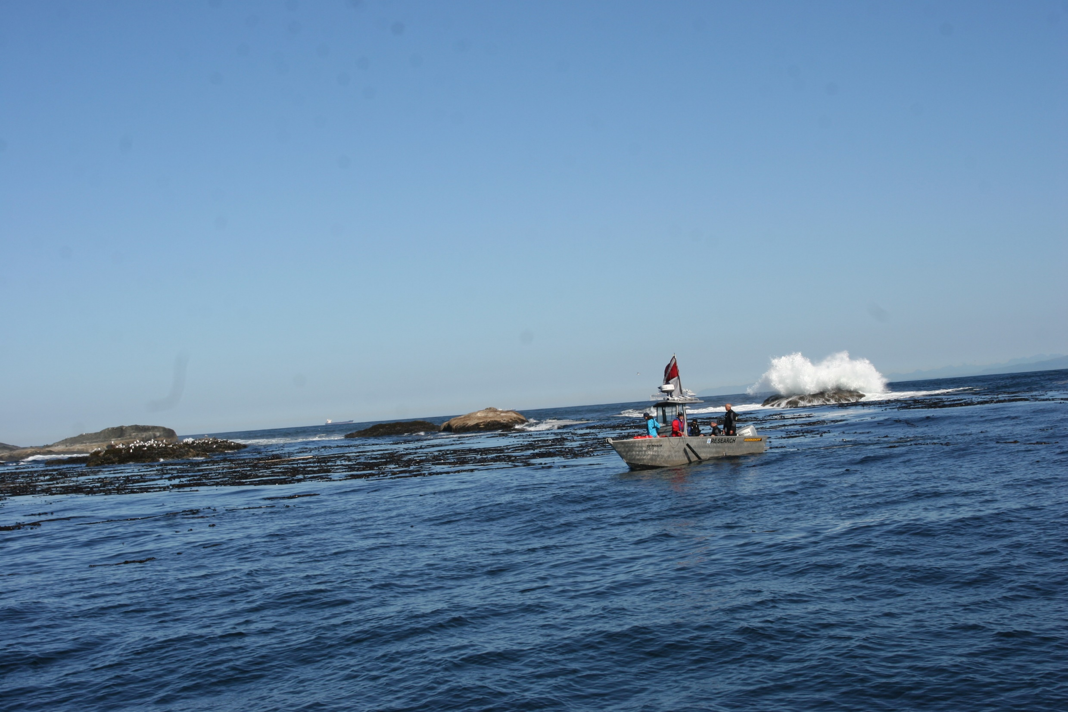
Our main objectives were to examine
(1) the prevalence, timing, and severity of MHWs and elevated SST in general along the Washington Coast
(2) if and how kelp forest communities changed in the periods during and following the 2014−2016 MHW and other warm SST anomalies, and SSWS
(3) whether community composition of kelps, invertebrates, and fishes was structured more by spatial differences or shared temporal variation
(4) whether we can detect interactions involving multiple guilds, which are hypothesized to structure kelp forest communities
Top-down effects of urchins on kelp
Bottom up effects of kelp cover on rockfish recruitment

Slide 4
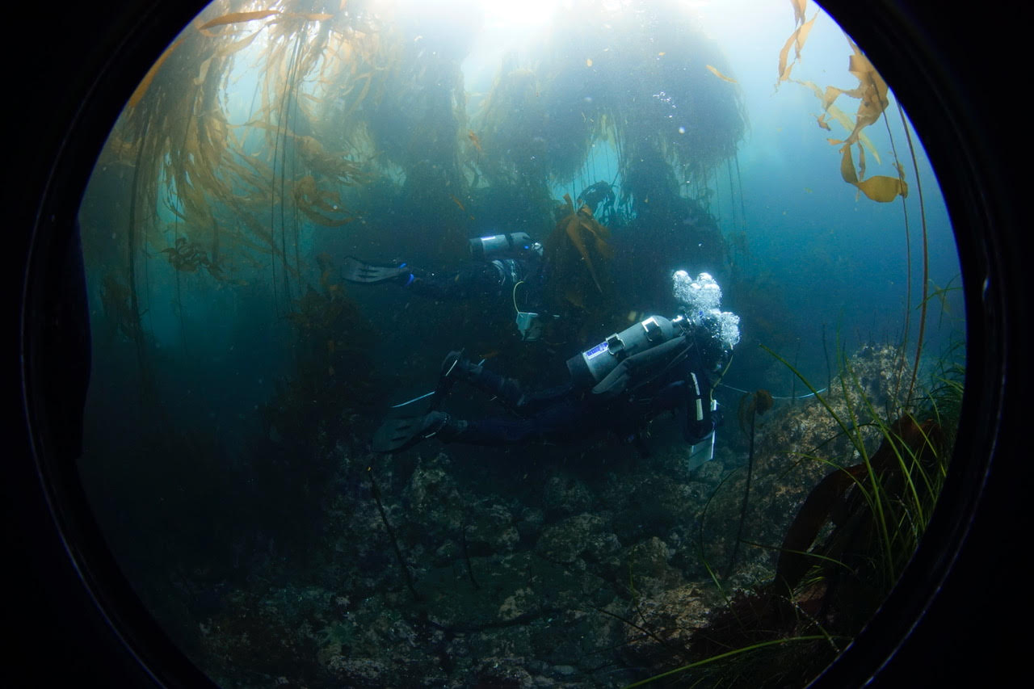
We sample five sites along the WA Coast within OCNMS
Neah Bay
Tatoosh Island
Cape Alava
Cape Johnson
Destruction Island
Two locations at each site
30 x 2 m transects
5 m and 10 m
Count & size fish and macroinvertebrates
Count kelp stipes (mostly Macrocystis, Nerocystis, Pterygophora)
Time series: 2015-2022 (no dive data before events)
Add: Kelp canopy survey data (DNR)

Slide 5
SST & Canopy kelps
2013 was HOT along the WA coast
2019 was also hot
2014-2016 was hotter than normal
WA coast did not see huge, persistent losses of canopy kelps
~50% Drop in canopy kelps in 2013 & 2014
Largely recovered by 2015

Slide 6
If the MHW occurred from 2014-2016, why was 2013 so warm?
MHWs are defined as anomalies
5+ day > 90%
Not absolute temperature
There were more, longer MHW events (red) in 2014-2016
BUT they occurred during slightly cooler portions of the year
MHW events in 2013 occurred during the warmest months
Absolute temp was higher in 2013

Slide 7
Trends in major focal groups
Kelps
stipe density increased from 2015
Urchins
164x increase in purple urchins
Then declined
Sea stars
Did not see that many
8 total Pycnopodia, none 2019 and 2021
Fish
Not much change
BUT Black rockfish increased
Rockfish YOY
Big recruitment of black/yellowtail in 2016

Slide 8
Why didn’t WA lose more kelp?
One potential reason…
Absolute temperature
vs
Temperature anomaly
MHWs defined by anomalies
WA coast did not get as hot as NoCal in absolute terms
Kelp growth declines in water > 15 C
Absolute temp a better predictor in other studies
Maximum monthly mean temperature
Washington (our sites)
15.1 C
14.5 C
Southern Oregon (no major kelp loss)
2014-2016 14.6
Northern California
2014-2016 16.0C

Slide 9
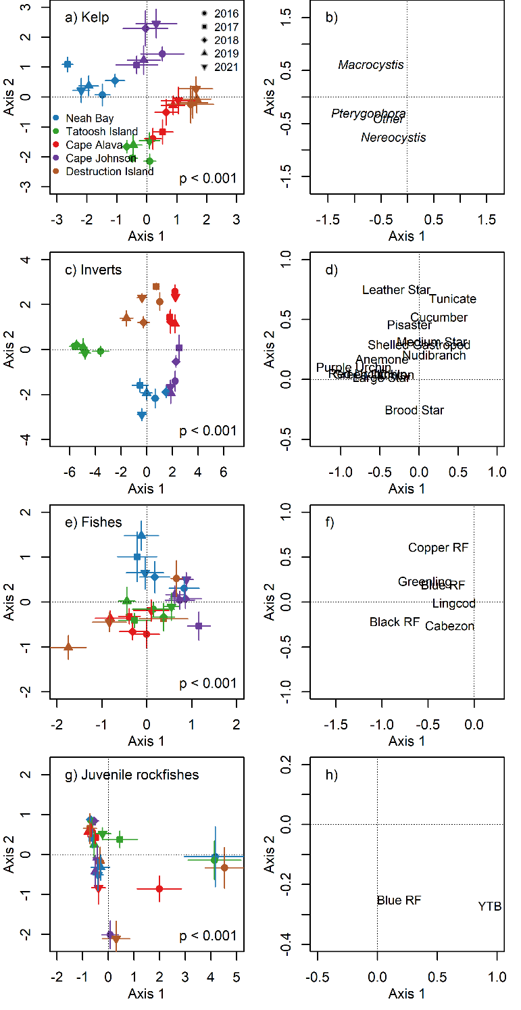
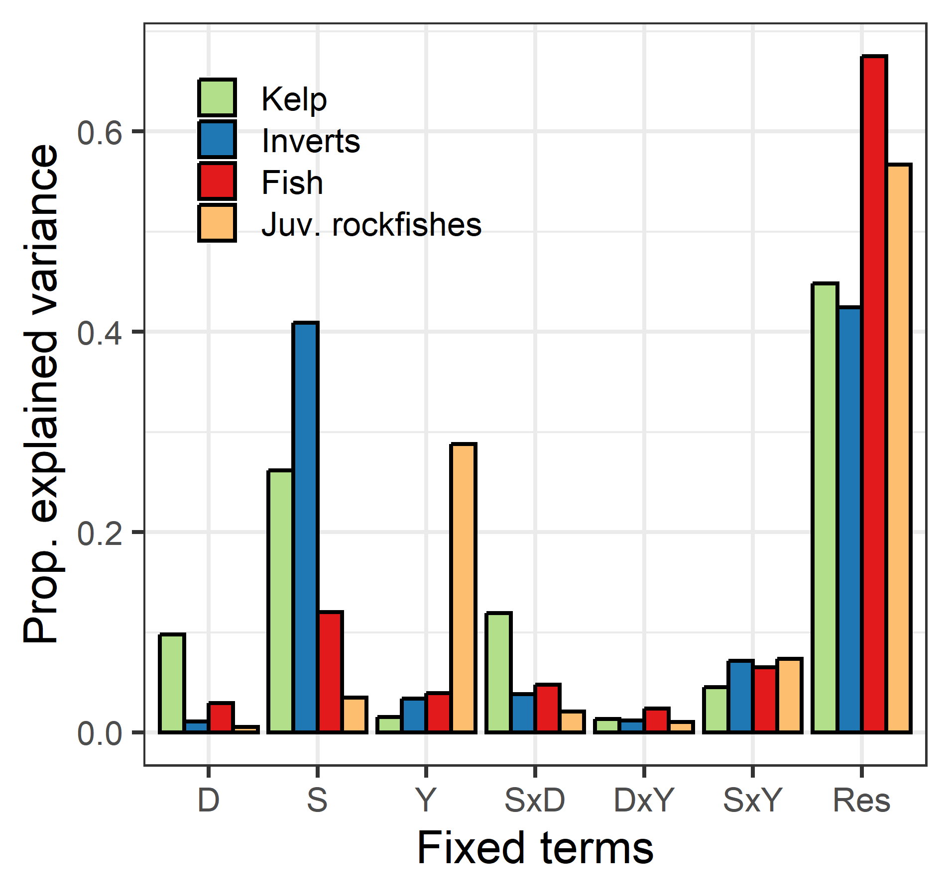
Canonical analysis of principal coordinates
Community structure
….was pretty stable through time
….sites were different
Kelp – invertebrates – fish
Site (spaces) accounted for most of the explained variation through time
Largely stable communities in terms of representation
Rockfish YOY (recruits)
Year was the most important
Less spatial structure
…as one would expect
Permutation-based MANOVA
D = Depth; S = Site; Y = Year

Slide 10
Top-down effects: Urchins eat kelp but…
….we did not see obvious relationships that would suggest that the urchin increase suppressed kelp
Why?
Max urchin densities were much lower than the outbreaks in NoCA that lead to canopy loss
Urchins behavior
Passive detritivores – eat drift kelp
Active herbivores – graze live kelp
Habitat complexity
Urchins mostly at Tatoosh Is.
Complex habitat retains drift kelp
Coastwide by year
Neah Bay
Site x Year
Tatoosh transects

Slide 11
Top-down effects: Urchins eat kelp
….BUT at the transect level, at Tatoosh Island
….Urchins may have created some patchiness within Nereocystis stands

Slide 12
Bottom up effects: Rockfish recruitment and canopy kelp
Work esp in CA suggests that kelp is important for rockfish recruitment
Essential fish habitat etc
Hurdle model
Presence / absence model
Positive density
Put back together for overall prediction of abundance
Presence/absence
More kelp higher probability of rockfish recruits (YOY)
Abundance
Year & Site but not kelp
Need kelp for recruits, but #’s are probably determined by other factors like larval supply

Slide 13
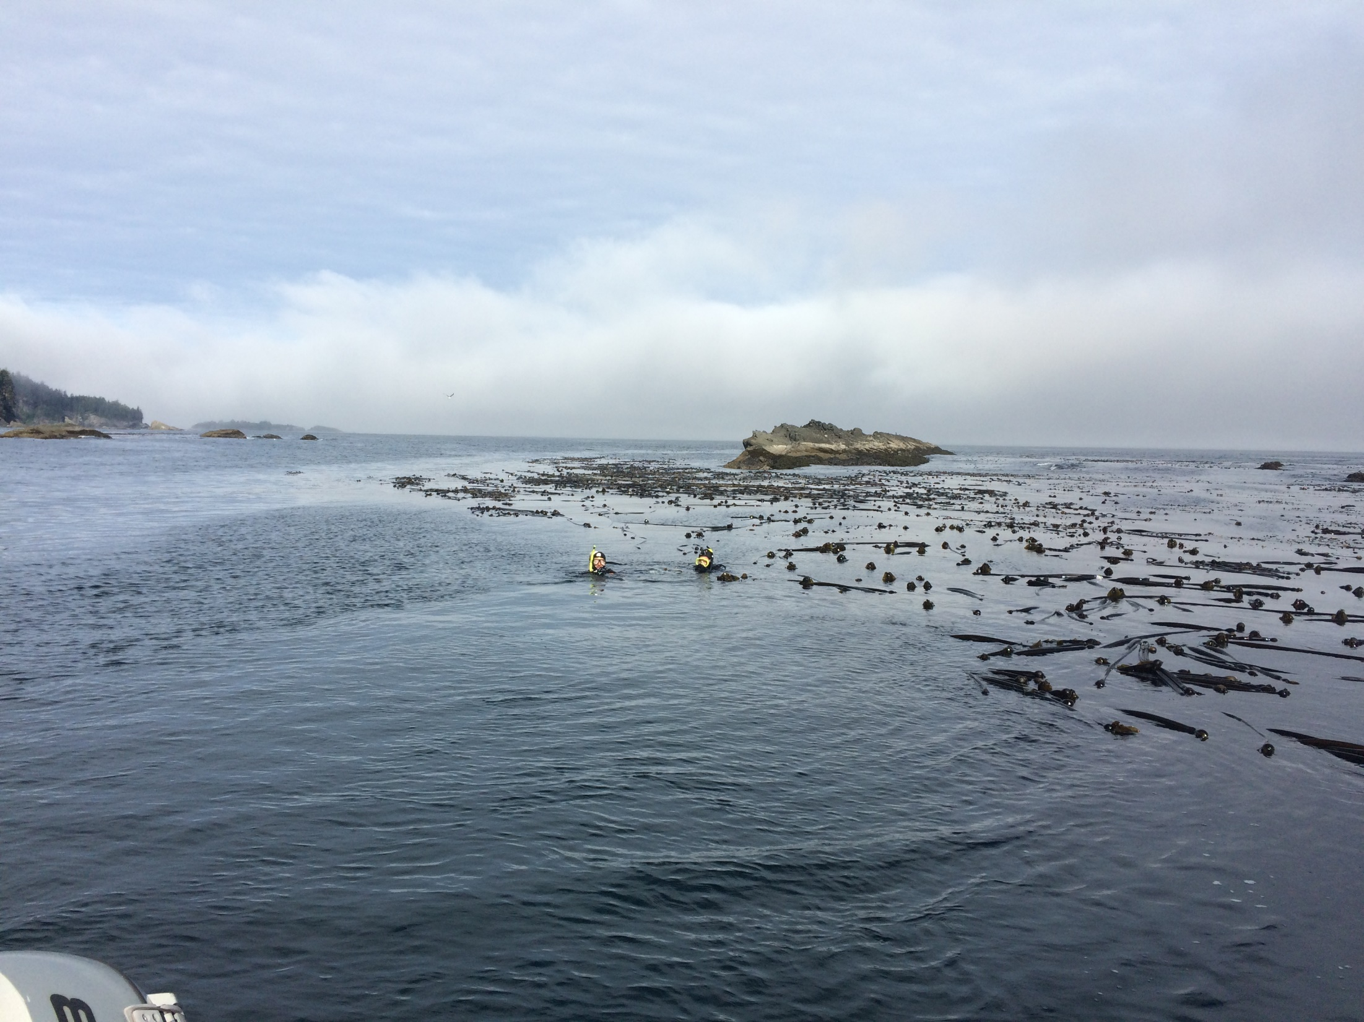
Summary / conclusions
The WA coast did get warm but in 2013
There was MHW activity on the WA coast BUT
The SST was not as warm in absolute terms as in NoCA
WA kelp communities were largely stable following a moderate loss of canopy cover
There ain’t no Pycno…at least in our surveys

